Slide 1
Artificial Intelligence
Intelligent Agents
Notes:
Slides and exercises are inspired by Russell & Norvig AI Book, Stanford’s AI course and from Berkeley’s AI course

Slide 2
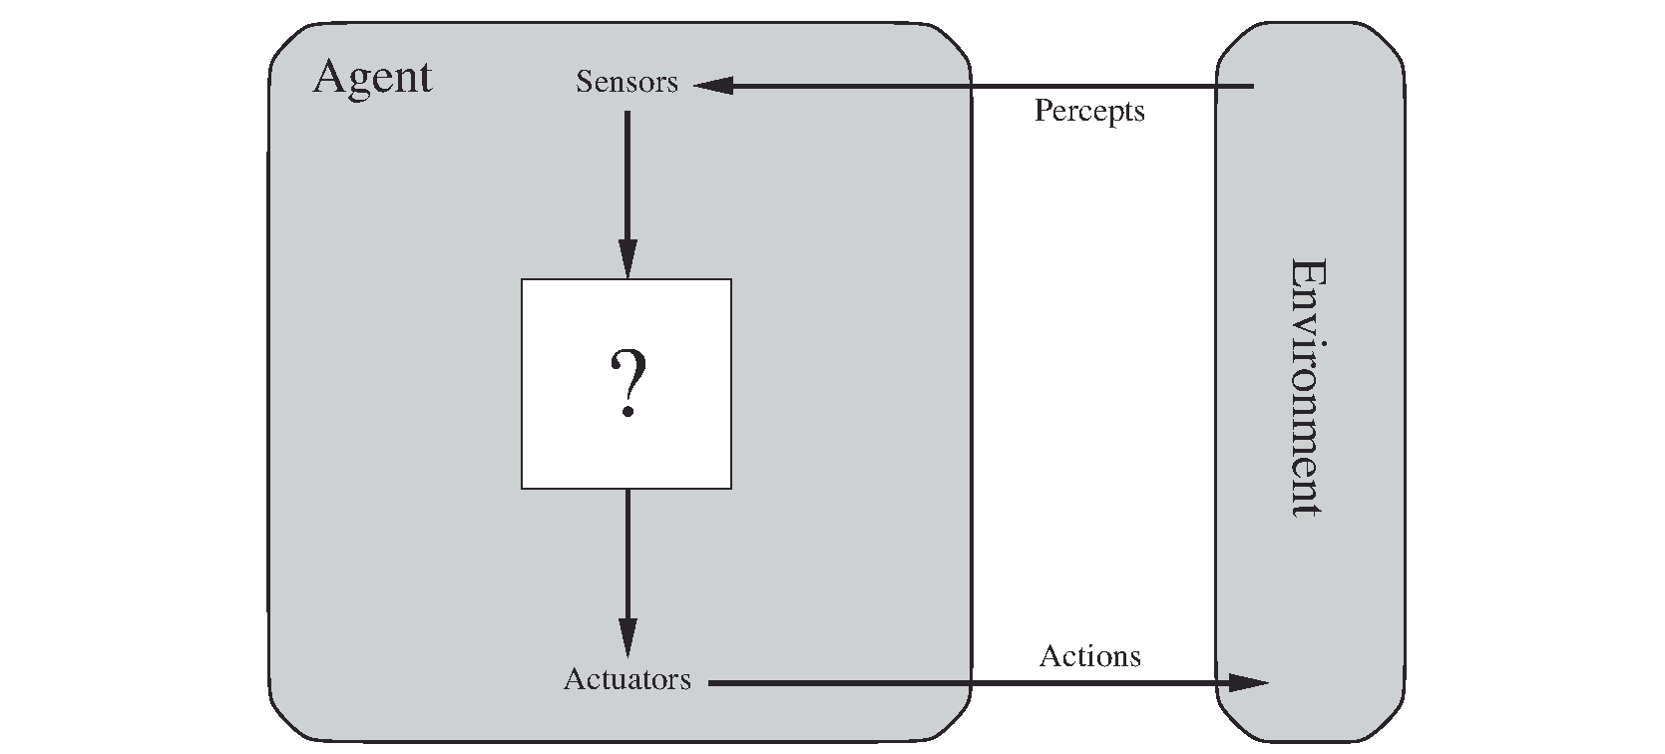
What is a rational agent ?
We’ll use the term rational in a very specific, technical way:
Rational: maximally achieving pre-defined goals
Rationality only concerns what decisions are made (not the thought process behind them)
Goals are expressed in terms of the utility of outcomes
Being rational means maximizing your expected utility
A rational agent is expected to maximize its performance measure given its percept sequence and built-in (prior) knowledge

Slide 3
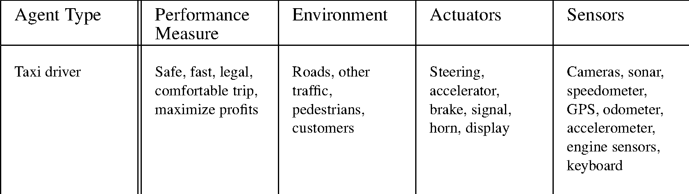
Example: taxi driver agent
PEAS: Performance, Environment, Actuators, Sensors

Slide 4
Terminology
Task environments:
Fully vs. partially observable
Deterministic vs. stochastic
Discrete vs. continuous
Benign vs. adversary (single agent vs. multi-agent)
Episodic vs. sequential
Known vs. unknown
Example :
checkers is ?

Slide 5
Terminology
Fully vs. partially observable
Deterministic vs. stochastic
Discrete vs. continuous
Benign vs. adversary
Example :
checkers is deterministic, discrete, adversarial, fully observable.
Poker is ?

Slide 6
Terminology
Fully vs. partially observable
Deterministic vs. stochastic
Discrete vs. continuous
Benign vs. adversary
Example :
checkers is deterministic, discrete, adversarial, fully observable.
Poker is ?

Slide 7
Terminology
Fully vs. partially observable
Deterministic vs. stochastic
Discrete vs. continuous
Benign vs. adversary
Example :
checkers is deterministic, discrete, adversarial, fully observable.
Poker is partially observable, stochastic, discrete and adversarial.

Slide 8
Terminology
Fully vs. partially observable
Deterministic vs. stochastic
Discrete vs. continuous
Benign vs. adversary
Example :
checkers is deterministic, discrete, adversarial, fully observable.
Poker is partially observable, stochastic, discrete and adversarial.
Robotic car is ?

Slide 9
Terminology
Fully vs. partially observable
Deterministic vs. stochastic
Discrete vs. continuous
Benign vs. adversary
Example :
checkers is deterministic, discrete, adversarial, fully observable.
Poker is partially observable, stochastic, discrete and adversarial.
Robotic car is partially observable, stochastic, continuous and benign.

Slide 10
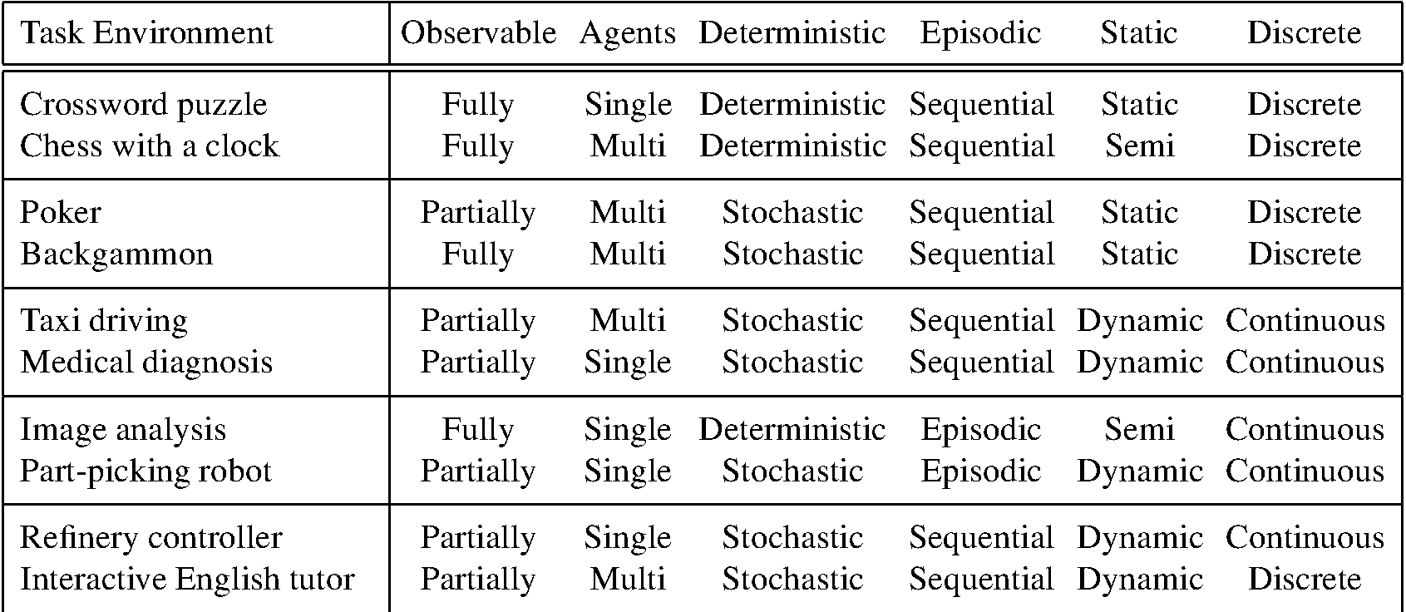
The nature of environments
Multi agent: cooperative or competitive (adversarial)?
Notes:
Dynamic : environment change over time
Semi-dynamic : If the environment itself does not change with the
passage of time but the agent’s performance score does

Slide 11
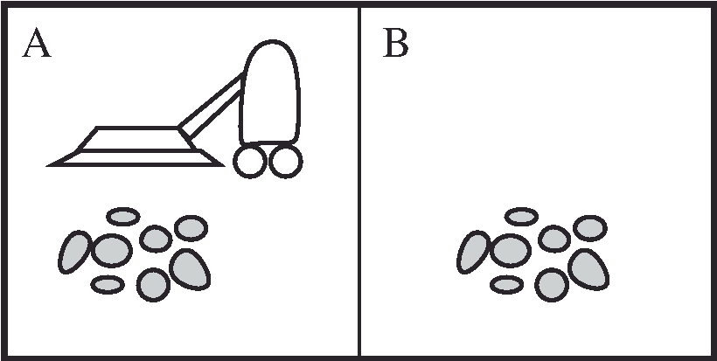
What is a search problem?
A search problem consists of:
Initial state: S0
A state space: S
Actions on states: a
A transition model: Result (S,a)
A goal test: S -> True|False
Path cost/ step cost: c(S,a,S’)
State space can be seen as a graph
A solution is a sequence of actions (a plan) which transforms the start state to a goal state
When the path cost is the lowest, we say that the solution is optimal
Example: A vacuum world with two locations

Slide 12
State space example
Actions:
Go left
Go right
Suck up

Slide 13
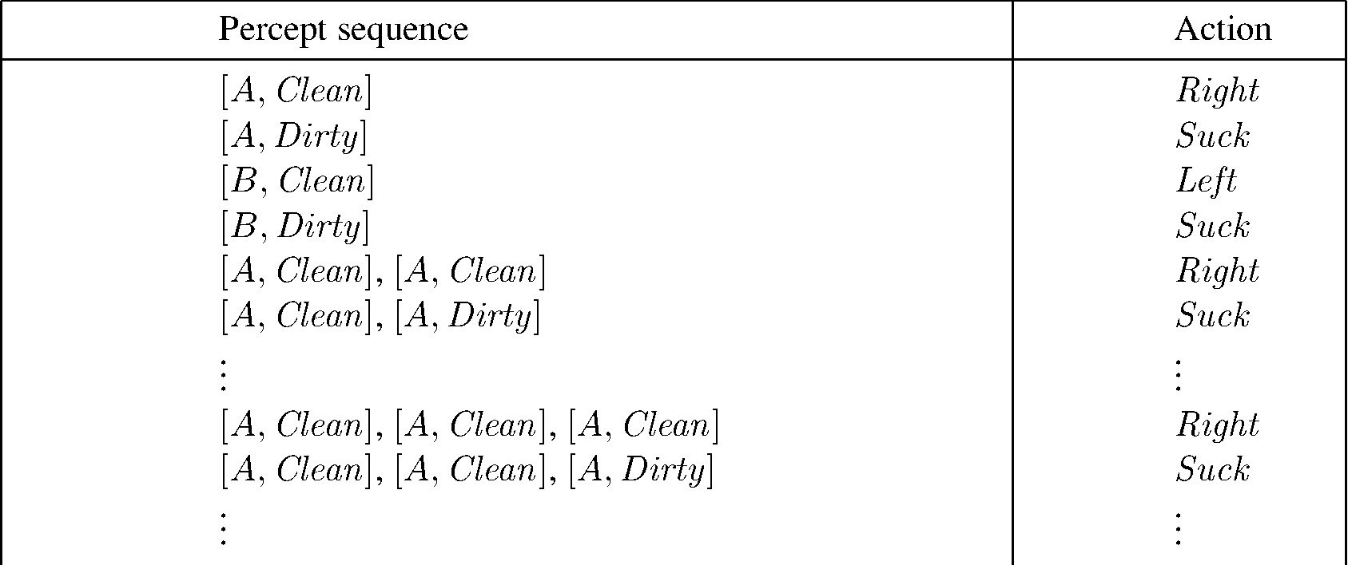
The agent function can be a Percept(s) / action table

Slide 14
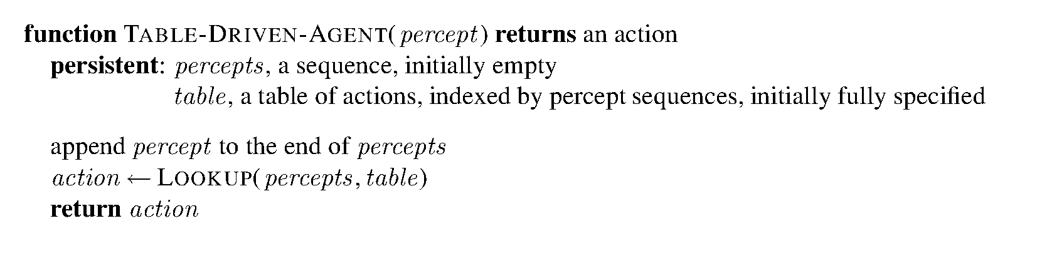
Table-driven agent

Slide 15
Agent types
Reflex Agents
Planning agents
Simple reflex agents;
Model-based reflex agents;
Choose action based on current percept (and maybe memory)
May have memory or a model of the world’s current state
Do not consider the future consequences of their actions
Consider how the world IS
Goal-based agents; and
Utility-based agents.
Ask “what if”
Decisions based on (hypothesized) consequences of actions
Must have a model of how the world evolves in response to actions
Must formulate a goal (test)
Consider how the world WOULD BE

Slide 16
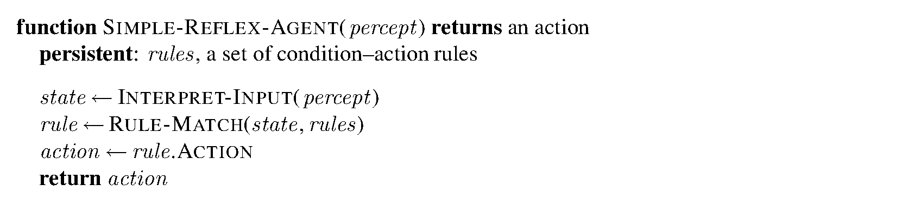
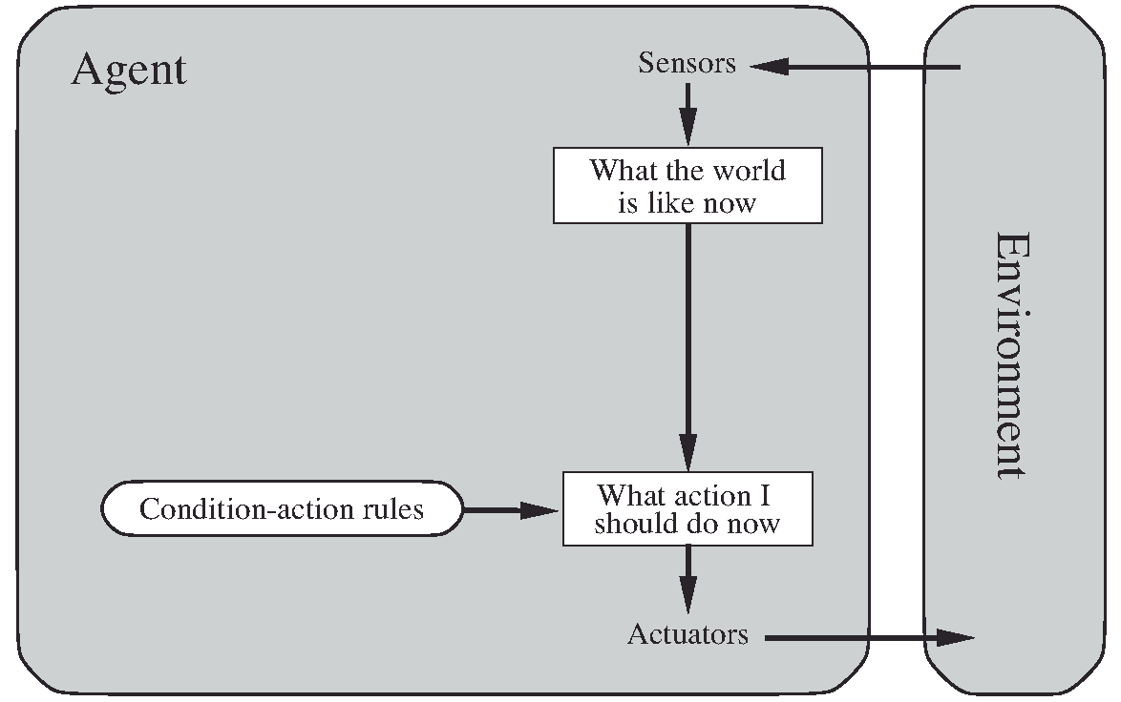
Simple reflex agent

Slide 17
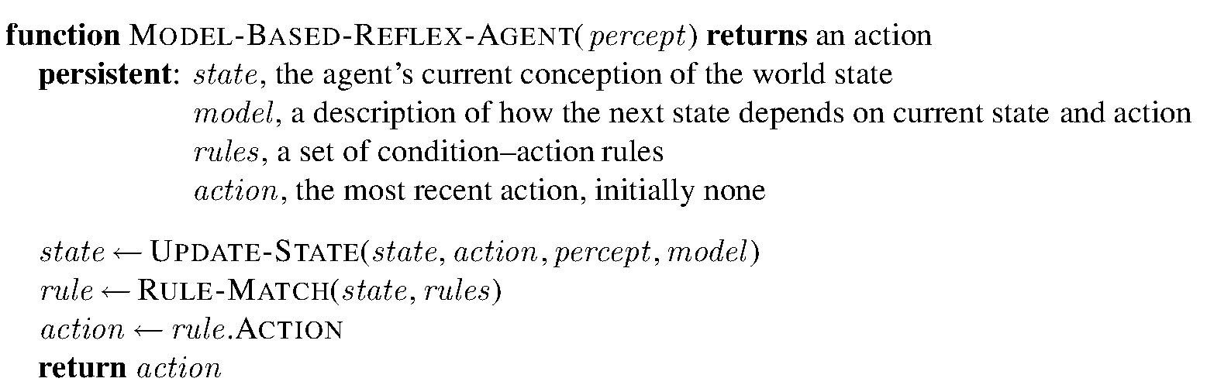
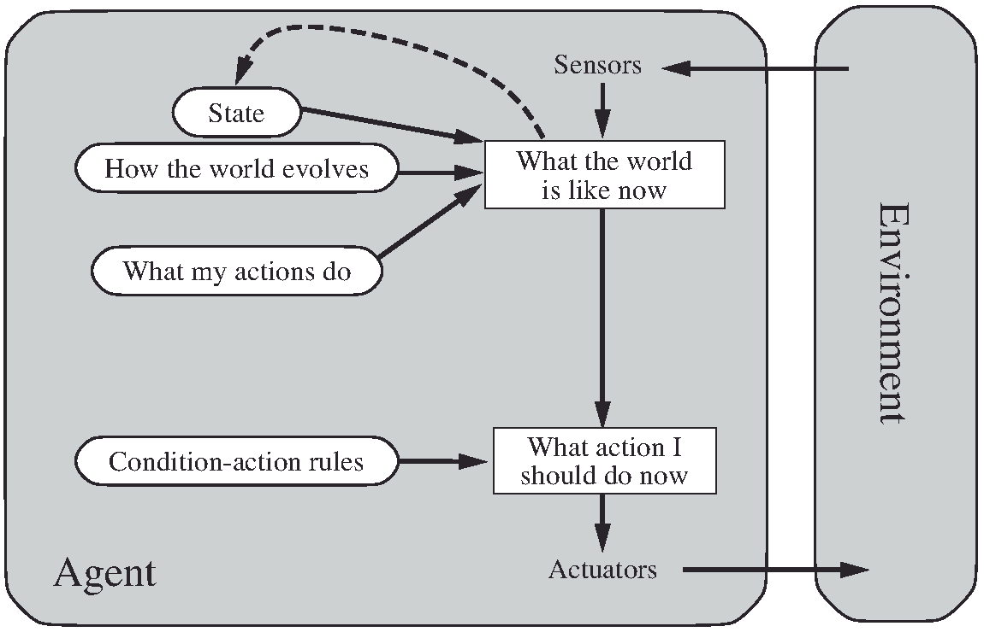
Model-based reflex agent

Slide 18
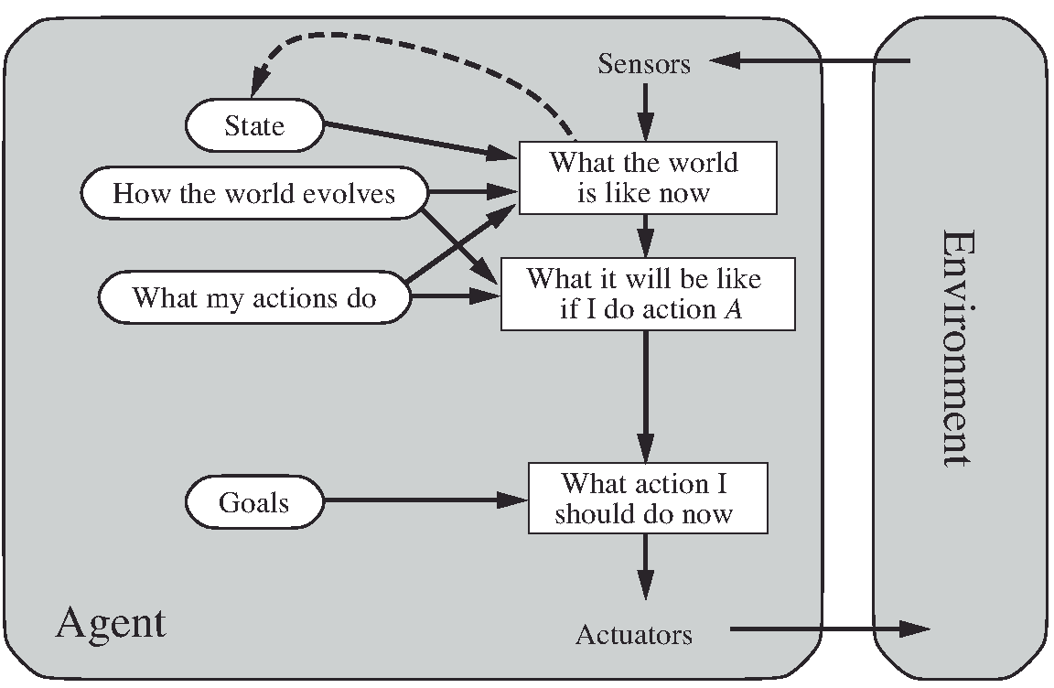
Model-based Goal-based agent

Slide 19
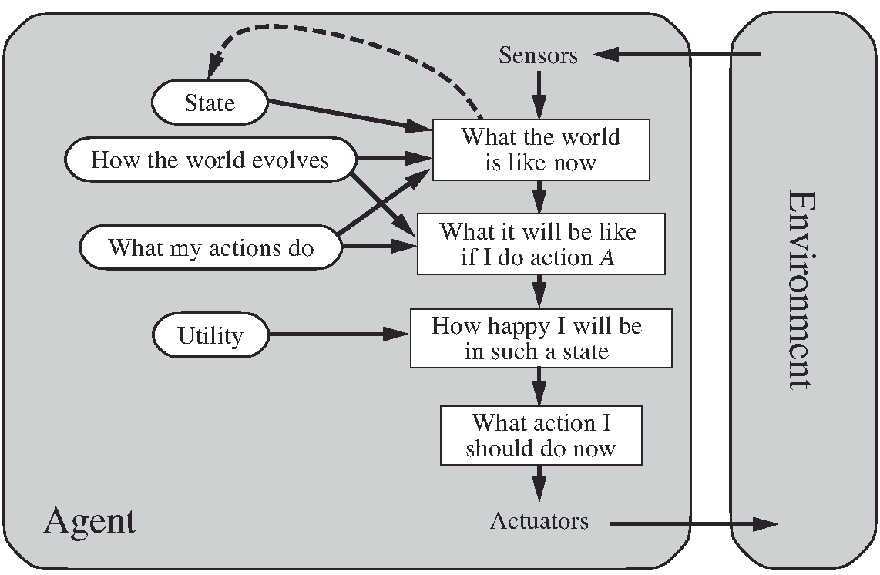
Model-based Utility-based agent

Slide 20
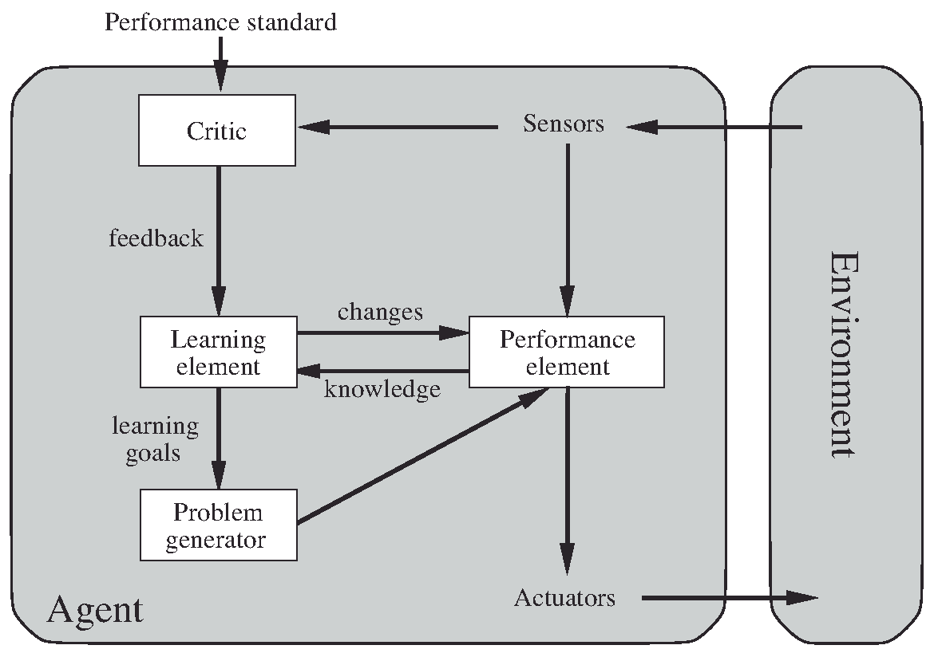
Learning agent

Slide 21
State representation (expressiveness)
Atomic
Search
Games
MDP
HMM
Factored
Constraint satisfaction CS
Propositional logic PL
Planning
Bayesian Networks
Machine learning
Structured
Relational databases
First-order logic
Natural language

Slide 22
Number of states exercise
Robot
2 positions
Each position is dirty or not
Number of states=?

Slide 23
Number of states exercise
Robot
2 positions
Each position is dirty or not
Number of states=8
Robot
On/off/sleep
Camera on/off
Brush height 1/2/3/4/5
10 positions
Number of states=?

Slide 24
Number of states exercise
Robot
2 positions
Each position is dirty or not
Number of states=8
Robot
On/off/sleep
Camera on/off
Brush height 1/2/3/4/5
10 positions
Each position is dirty or not
Number of states=307200
Notes:
3*2*5*2**10*10

Slide 25
Pacman
World state:
Agent positions: 120
Food count: 30
Ghost positions: 12
Agent facing: NSEW
How many World states?

Slide 26
Pacman
World state:
Agent positions: 120
Food count: 30
Ghost positions: 12
Agent facing: NSEW
How many World states?
120x(2³⁰)x(12²)x4
States for pathing?

Slide 27
Pacman
World state:
Agent positions: 120
Food count: 30
Ghost positions: 12
Agent facing: NSEW
How many World states?
120x(2³⁰)x(12²)x4
States for pathing?
120
States for eat-all-dots?

Slide 28
Pacman
World state:
Agent positions: 120
Food count: 30
Ghost positions: 12
Agent facing: NSEW
How many World states?
120x(2³⁰)x(12²)x4
States for pathing? (describe a path)
120
States for eat-all-dots and describe a path?
120x(2³⁰)

Slide 29
Summary
An agent is something that perceives and acts in an environment.
The agent function for an agent specifies the action taken by the agent in response to any percept sequence.
The performance measure evaluates the behavior of the agent in an environment. A rational agent acts so as to maximize the expected value of the performance measure, given the percept sequence it has seen so far.
A task environment specification includes the performance measure, the external environment, the actuators, and the sensors (PEAS). In designing an agent, the first step must always be to specify the task environment as fully as possible.
Task environments vary along several significant dimensions. They can be fully or partially observable, single-agent or multiagent, deterministic or stochastic, episodic or sequential, static or dynamic, discrete or continuous, and known or unknown.

Slide 30
Summary
The agent program implements the agent function. There exists a variety of basic agent-program designs reflecting the kind of information made explicit and used in the decision process.
The designs vary in efficiency, compactness, and flexibility. The appropriate design of the agent program depends on the nature of the environment.
Simple reflex agents respond directly to percepts, whereas model-based reflex agents maintain internal state to track aspects of the world that are not evident in the current percept.
Goal-based agents act to achieve their goals, and utility-based agents try to maximize their own expected “happiness.”
All agents can improve their performance through learning.

